Slide 1
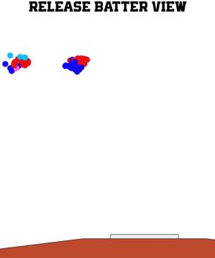
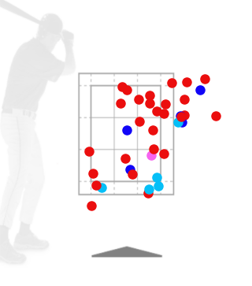
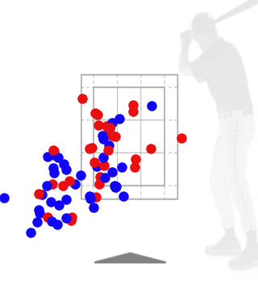
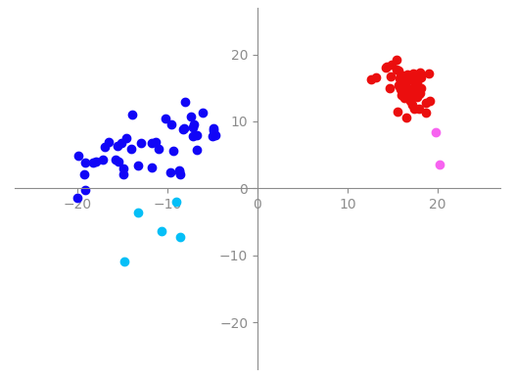
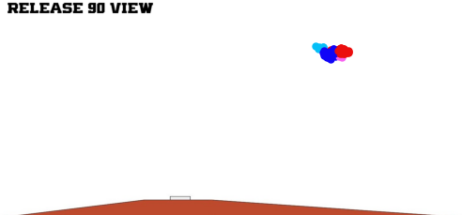

Paul Skenes
Pitcher Report
April 13 vs Kentucky
Pitch Type | # | AVG Velo | MAX Velo | AVG Spin | MAX Spin | Vert Break | Horz Break | Tilt | InZone VAA | Rel Height | Rel Side | Exten-sion | Strike% | Whiff%
Fastball | 59 | 98.3 | 100.7 | 2461 | 2601 | 15.4 | 16.6 | 1:39 | -5.14 | 6.06 | 2.81 | 5.53 | 69% | 19%
Slider | 46 | 85.3 | 88.1 | 2348 | 3469 | 6.1 | -11.9 | 9:50 | -6.95 | 5.92 | 2.36 | 5.08 | 63% | 71%
Curveball | 5 | 82.7 | 83.8 | 2899 | 3004 | -6.0 | -11.3 | 7:56 | -9.11 | 6.20 | 3.81 | 4.73 | 60% | N/A
ChangeUp | 2 | 92.9 | 95.3 | 2064 | 2238 | 6.0 | 20.0 | 2:33 | -6.19 | 5.84 | 4.02 | 5.50 | 50% | 0%
Balls in Play | 13
AVG EV | 90.0
Hard Hit % | 50.0%
Grounder % | 58.3%
Count | Pitches | Strikes | Strike%
0-0 | 27 | 11 | 41%
1-1 | 9 | 4 | 44%
Fastball
Cutter
Slider
Curveball
ChangeUp
Splitter

